Slide 1
Enhancing Customer Convenience with AI
Implementing a Multi-Functional Chatbot in Restaurants

Slide 2
ABSTRACT
This project aims to create a conversational AI chatbot for a restaurant using the open-source framework, Rasa. The chatbot will provide customers with the ability to order food, book tables, and place takeaway orders through a natural language interface.
In the past, restaurants have relied on traditional methods such as phone calls or in-person visits to place orders and book tables. This approach has several disadvantages, including long wait times, difficulty in tracking orders, and a limited ability to handle high volumes of customer requests.
By implementing a Rasa-based chatbot, restaurants can improve the customer experience by providing a faster and more convenient way to place orders and book tables. The chatbot can be integrated into existing restaurant systems, allowing for seamless order tracking and management.

Slide 3
The Rasa framework offers several advantages over other conversational AI platforms, including its flexibility, customizability, and scalability. Rasa uses a combination of machine learning algorithms and rule-based systems to understand and respond to customer requests, allowing for a highly accurate and natural conversation.
With the use of the Rasa chatbot, restaurants can streamline their operations, improve customer satisfaction, and keep pace with the growing demand for digital ordering and booking services. This project demonstrates the potential for Rasa to revolutionize the way restaurants interact with their customers and highlights its capabilities as a powerful tool for building conversational AI systems.

Slide 4
EXISTING SYSTEM
In the existing system, a chatbot has been created specifically for the university utilizing the Myanmar language. This chatbot aims to provide a convenient and accessible platform for students, staff, and faculty to gather information and receive assistance. The chatbot leverages advanced Natural Language Processing techniques to understand the queries and provide accurate and relevant responses.
By incorporating the Myanmar language, the chatbot caters to the local language preferences and enhances the overall user experience. Additionally, the chatbot is available 24/7, making it accessible to users at any time and from any location. With this innovative technology, the university is working towards providing a more efficient and effective means of communication for its community.

Slide 5
LITERATURE SURVEY
The hotel business stands to benefit greatly from chatbots in several ways. Accessibility to the company's offers is crucial for the consumer in any business, both during the presale and after the sale. The simplicity of use may now be further improved by a firm by providing all of its services where consumers are already speaking with their friends, since more and more people utilise instant messaging platforms like Facebook Messenger and WhatsApp. Chatbots are highly regarded for carrying out typical administrative and menial duties, such as organising appointments, making reminders, booking tables, and sharing traffic. In this section, the existing Chabot methodology for different industry is discussed for better understanding of proposed model.

Slide 6
PROPOSED SYSTEM
Natural Language Understanding (NLU) Component
Dialogue Management Component
Action Server
User Interface
Backend System
proposed system is designed to provide customers with a convenient and accessible way to interact with the restaurant and place orders. The chatbot uses NLP and machine learning algorithms to understand the customer's requests and provide relevant responses, reducing the workload on the restaurant's staff and improving efficiency.

Slide 7
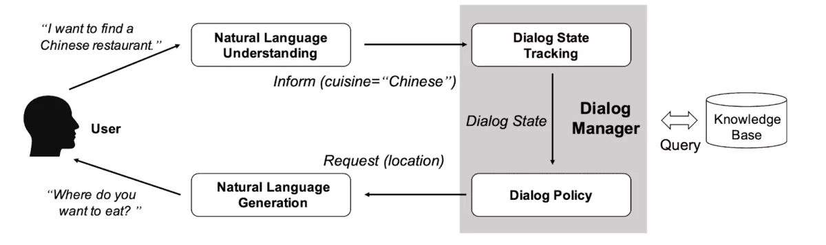
ARCHITECTURE
Chatbot
User interface
Trained system
input
NLU
Natural language understanding
Dialogue management system
What is the special menu today
User
Todays special menu
Italian Lasagne
Focaccia
output
Response
Action server

Slide 8
TOOLS USED
Hardware Requirements:
Computer
RAM
Storage
GPU
Software Requirements:
Rasa
Python
Anaconda

Slide 9
MODULES
Requirements Gathering
Data Collection
Model Training
Dialogue Design
Action Design
Deployment
Maintenance and Monitoring

Slide 10
STATUS OF THE PROJECT
The structural work of the chatbot has been completed, and the focus has now shifted to training the chatbot. Training a chatbot is a crucial step in the development process as it involves feeding the chatbot with data to help it understand user inputs and generate relevant responses. The training work of the chatbot is currently in progress and is expected to take some time to complete. Once the training is completed, the chatbot will undergo testing and further refinement before it is deployed for use. Overall, the project is progressing as planned, and the team is working diligently to deliver a functional and effective chatbot for the restaurant.

Slide 11
PROJECT GUIDE MEETINGS DETAIL
S.NO | DATE | SUGGESTION FROM FROM GUIDE

Slide 12
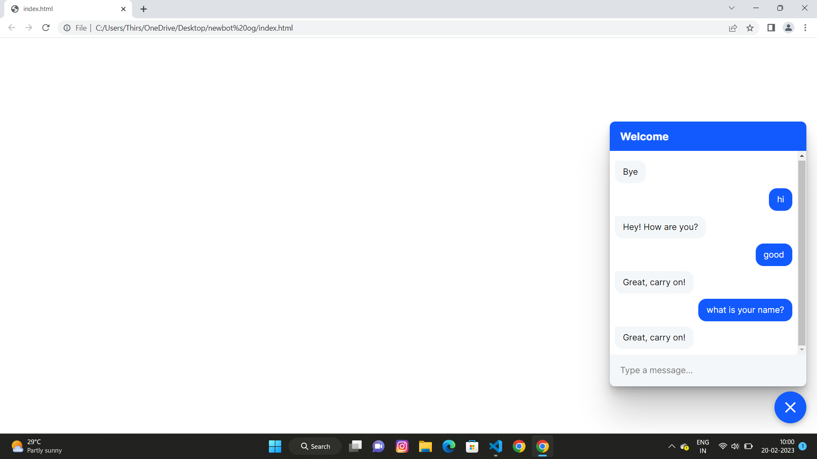
SAMPLE SCREEN SHOTS

Slide 13
GITHUB SCREEN SHOT

Slide 14
THANKYOU

